Slide 1
Data Warehousing & Architecture of Data Warehouse

Slide 2
Introduction to Data Warehousing
Examples and Exercises

Slide 3
What is Data Warehousing?
A data warehouse is a relational database or centralized repository that stores large volumes of historical data from multiple sources, optimized for query and analysis.
It provides integrated, enterprise-wide, historical data
It focuses on providing support for decision-makers for data modeling and analysis

Slide 4
History of Data Warehouse
Barry Devlin and Paul Murphy were the researchers of IBM in 1980’s. They introduced the idea of data warehousing and after they established the "Business Data Warehouse.“
The data warehousing idea was planned to support an architectural model for the flow of information from the operational system to decisional support environments.

Slide 5
Data Warehousing Objectives
To connect multiple data sources
To help reporting as well as analysis
Maintain the organization's historical information
Be the foundation for decision making.

Slide 6
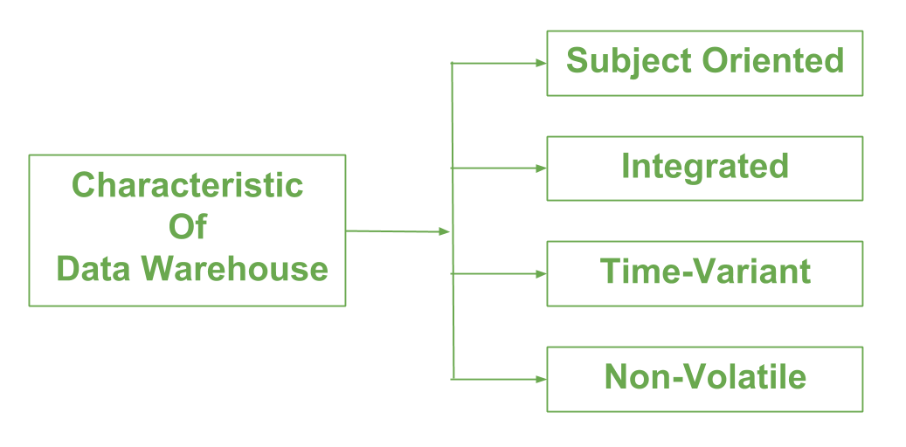
Characteristics of Data Warehouse

Slide 7
Characteristics of Data Warehouse
Integrated Data: One of the key characteristics of a data warehouse is that it contains integrated data. This means that the data is collected from various sources, such as transactional systems, and then cleaned, transformed, and consolidated into a single, unified view.
Subject-Oriented: A data warehouse is also subject-oriented, which means that the data is organized around specific subjects, such as customers, products, or sales.

Slide 8
Characteristics of Data Warehouse
Non-Volatile: Another characteristic of a data warehouse is that it is non-volatile. This means that the data in the warehouse is never updated or deleted, only added to.
Time-Variant: A data warehouse is also time-variant, which means that the data is stored with a time dimension. This allows for easy access to data for specific time periods

Slide 9
Components of a Data Warehouse
Data Sources:
Operational databases (ERP, CRM, etc.)
External sources (market data, social media)
ETL Process:
Extract, Transform, Load data into the warehouse.
Data Storage:
Centralized storage of integrated data.

Slide 10
Components of a Data Warehouse
Metadata:
Data about the data (definitions, relationships, etc.)
Access Tools:
Reporting, analysis, and data mining tools.

Slide 11
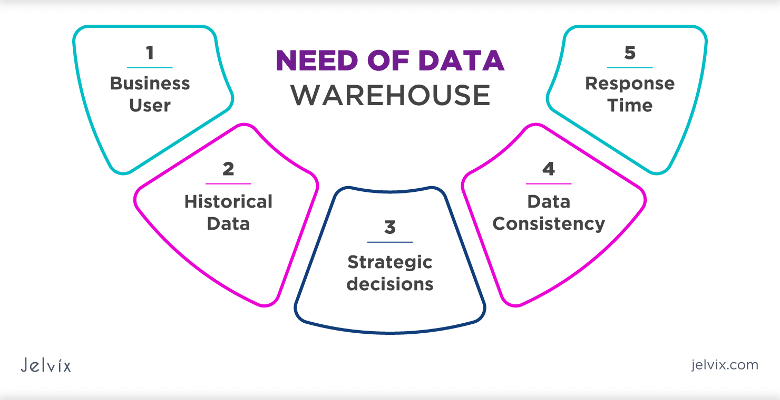
Need for Data Warehouse

Slide 12
Necessity of Data Warehouse
Data Warehouse is necessary for the following reasons:
Business User: Business users require a data warehouse to view summarized data from the past.
Historical data: Data Warehouse is required to store the time variable data from the past. This input is made to be used for various purposes
Strategic decisions: Some strategies may be depending upon the data in the data warehouse. So, data warehouse contributes to making strategic decisions

Slide 13
Necessity of Data Warehouse
Data consistency: Bringing the data from different sources at a commonplace, the user can effectively undertake to bring the uniformity and consistency in data.
Response time: Data warehouse has to be ready for somewhat unexpected loads and types of queries, which demands a significant degree of flexibility and quick response time

Slide 14
Advantages of Data Warehouse
Data warehouses facilitate end users' access to a variety of data
Makes selections with higher quality
Storage of analyses and historical search queries is quite beneficial.
Using numerous data warehouses can increase the operational value of business systems, especially customer relationship management

Slide 15
Disadvantages of Data Warehouse
Data warehouses could soon become outdated.
The operating systems must be reorganized to accommodate them.
They were designed in a sophisticated, multidisciplinary manner.
It might be challenging to include new data sources once a system has been implemented.

Slide 16
Architecture of Data Warehouse OLAP(Online analytical processing)

Slide 17
Non-trivial functional dependency
A → B has a non-trivial functional dependency if B is not a subset of A
When A intersection B is NULL, then A → B is called as complete non-trivial.
Example:
ID → Name,
Name → DOB

Slide 18
Advantages of Functional Dependencies
Helps identify redundancy in database tables
Fundamental to the process of normalization
Ensures data consistency and integrity
It makes simpler to add, edit, and remove data, which helps with database management

Slide 19
Disadvantages of Functional Dependencies
The process of identifying functional dependencies can be time-consuming and complex, especially in large databases with many tables and relationships
Overly restrictive functional dependencies can result in slow query performance or data inconsistencies, as data that should be related may not be properly linked

Slide 20
Normalization
Normalization is the process of organizing the data in the database
It is used to minimize the redundancy from a relation or set of relations.
It is also used to eliminate undesirable characteristics like Insertion, Update, and Deletion Anomalies

Slide 21
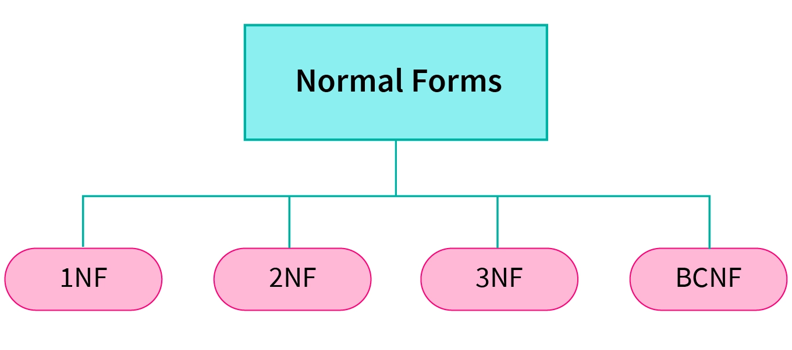
Normalization Forms

Slide 22
Advantages of Normalization
Normalization helps to minimize data redundancy.
Greater overall database organization.
Data consistency within the database.
Much more flexible database design.
Enforces the concept of relational integrity.

Slide 23
Disadvantages of Normalization
You cannot start building the database before knowing what the user needs.
The performance degrades when normalizing the relations to higher normal forms, i.e., 4NF, 5NF
It is very time-consuming and difficult to normalize relations of a higher degree.

Slide 24
1NF (Normal Form)
A relation will be 1NF if it contains an atomic value.
An attribute of a table cannot hold multiple values. It always hold only single-valued attribute.
1NF Form disallows the multi-valued attribute, composite attribute, and their combinations
Each entry in a column must contain a single value.

Slide 25
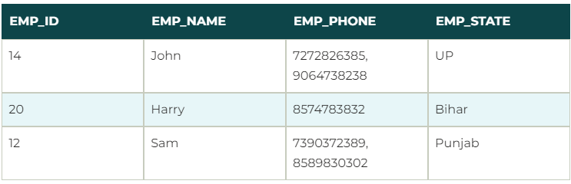
Example of 1NF
Relation EMPLOYEE is not in 1NF because of multi-valued attribute EMP_PHONE

Slide 26
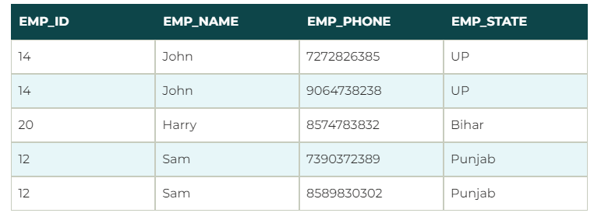
Example of 1NF
After applying 1NF Form on the EMPLOYEE relation we get following:

Slide 27
2NF (Normal Form)
In the 2NF, relational must be in 1NF
In the second normal form, all non-key attributes are fully functional dependent on the primary key
Eliminate partial dependencies (non-prime attributes must depend on the entire primary key).

Slide 28
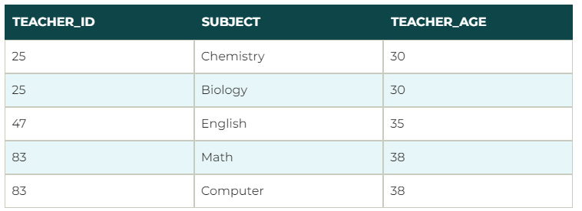
Example of 2NF
Let's assume, a school can store the data of teachers and the subjects they teach. In a school, a teacher can teach more than one subject.

Slide 29
Example of 2NF
to convert the given table into 2NF, we decompose it into two tables:
In the given table, non-prime attribute TEACHER_AGE is dependent on TEACHER_ID which is a proper subset of a candidate key. That's why it violates the rule for 2NF

